Slide 1

Scalextric 2’
Simcha Newman
Haziq Shazad
Kahled Muwahed
Agata Sakowicz
James Rudd

Slide 2


MEET OUR CLIENT
DigitalLabs:
An on-campus small enterprise who work in three areas. Software development, product development and teaching.
Provide workshops on different subjects to a variety of students.
Located in the shed right next to the John Darlton building.

Slide 3
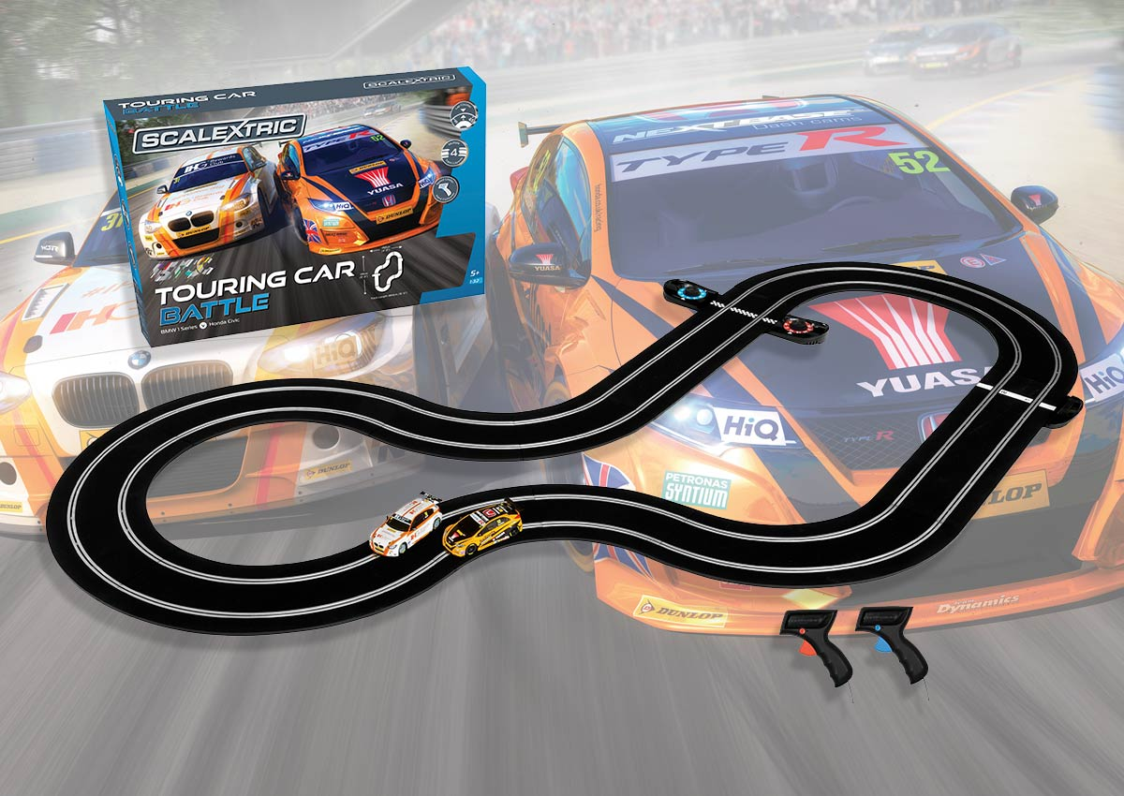
An intro to Scalextric…
Popular children’s slot car game which enabled people to race toy cars.
This achived via controllers that sent an electronic frequency to the track, depending on the pressure on the trigger.
Scalextric.com. (2019). Scalextric standard sets, mclaren p1, monster trucks & more. [online] Available at: https://www.scalextric.com/uk-en/shop/sets/race-sets.html [Accessed 27 Nov. 2019].

Slide 4
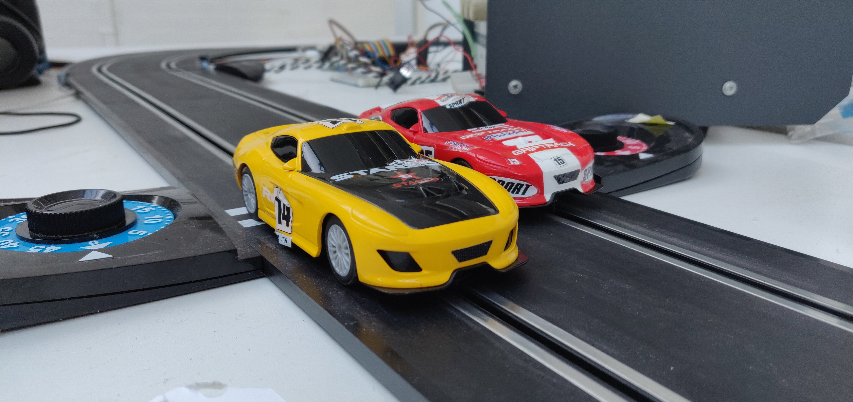


The Project overview
Create a SPWA (single-page web application) which will control the track.
This will be done using the Publish and Subscribe technique.
The track will pick up signals from a Raspberry PI using python and communicate back with our MQTT mosquito server.
Technologies that we must learn?
MQTT - Core
AngualrJS – Core
NodeRED – Review and understand
JSON - Core
Python – Optional

Slide 5
GAMEPLAY!!!
A player will scan a QR code and onboard onto a track of our platform.
They will have instructions on how to play the game.
They will then have numerous game modes to play on; Casual by them self, Casual with someone else and Racing each other.
Each player will have abilities and defences E.G. puncture.
There will also be live stat updates on how the player is doing.

Slide 6
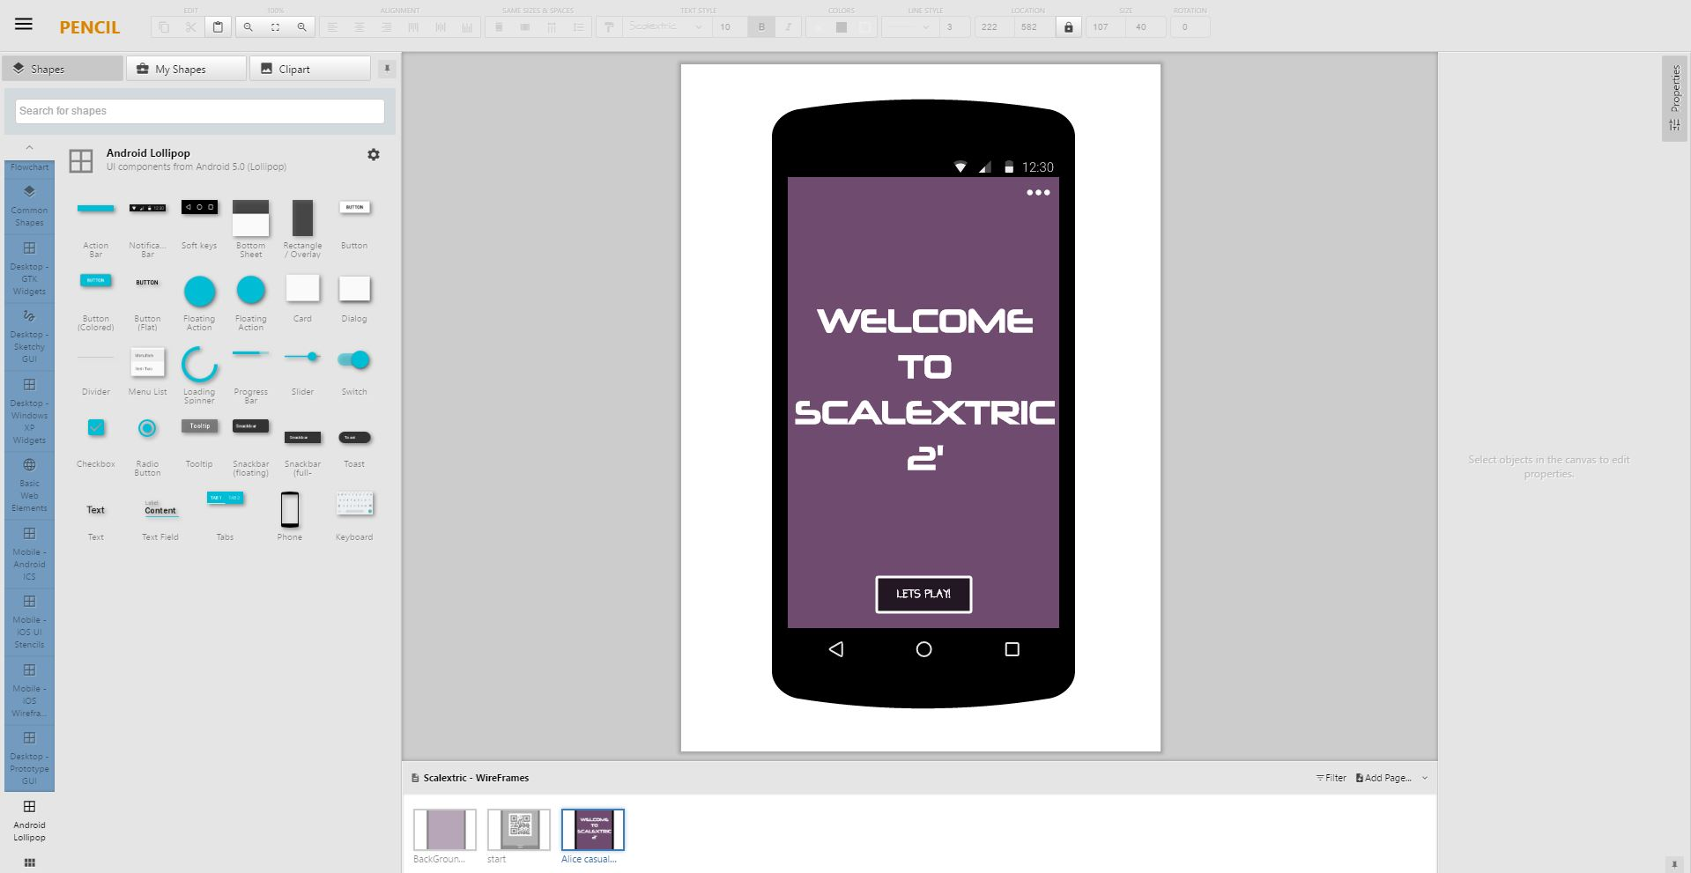
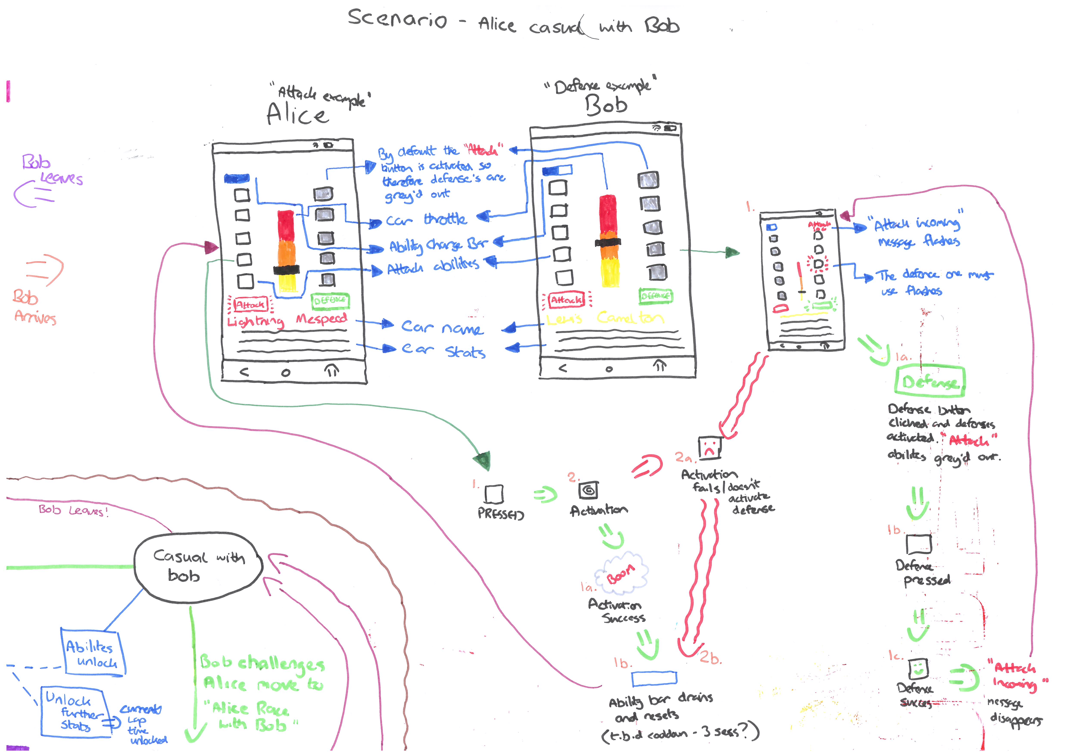
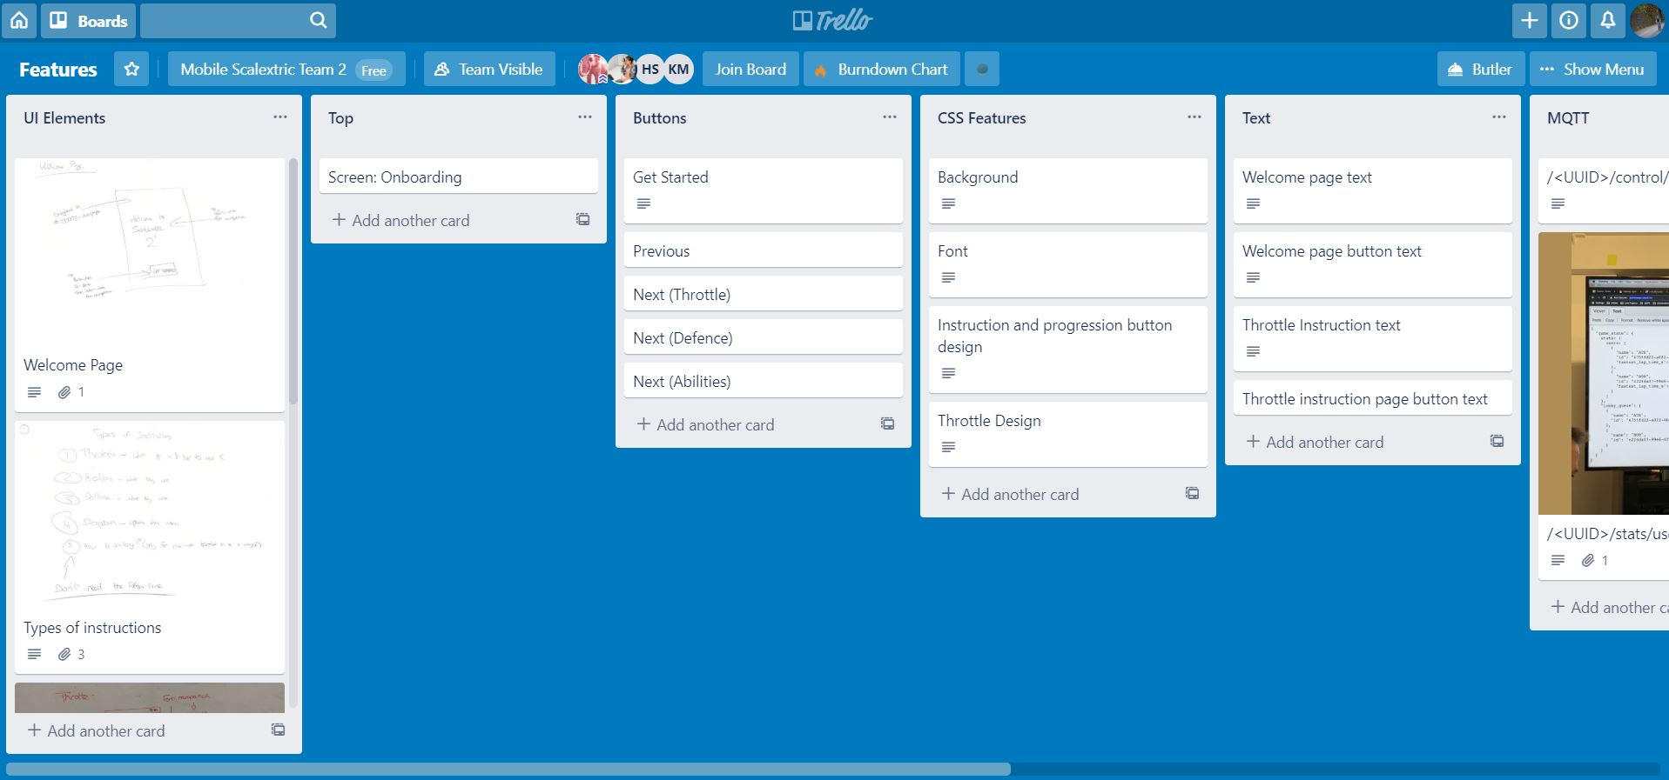
MORE TO COME
Github
Trello
Wireframes
Agile
MQTT Box

Slide 7

QUESTIONS?

